Slide 1

Model Evaluation & Validation: Predicting Housing Prices
This presentation explores techniques for evaluating and validating machine learning models to predict housing prices. We'll examine data exploration, model development, performance analysis, and making predictions on real-world data.
ME
Menna Mahmoud EL-Bagoury

Slide 2


Data Exploration
We begin by exploring the Boston housing dataset, containing 489 data points with 4 key features. Understanding the data distribution and relationships is crucial before modeling.
1
Key Features
2
Data Preparation
3
Statistical Analysis
Room count (RM), neighborhood poverty (LSTAT), student-teacher ratio (PTRATIO), and median home value (MEDV).
Removed outliers and scaled the target variable to account for 35 years of inflation.
Calculated minimum, maximum, mean, median, and standard deviation of home prices.

Slide 3
Performance Metric: R-squared
We use the coefficient of determination (R-squared) to quantify model performance. It measures the proportion of variance in the target variable explained by the features.
R-squared Range
Interpretation
Implementation
Values range from 0 to 1. Higher values indicate better predictive power.
R-squared of 0.40 means 40% of variance in Y is predictable from X.
We use sklearn's r2_score function to calculate R-squared for our models.

Slide 4

Data Splitting: Train-Test
We split the data into training (80%) and testing (20%) subsets. This allows us to evaluate model performance on unseen data.
1
Shuffle Data
Randomize data order to remove potential bias in the dataset.
2
Split Data
Divide into 80% training and 20% testing subsets using train_test_split.
3
Assign Variables
Store splits in X_train, X_test, y_train, and y_test variables.

Slide 5
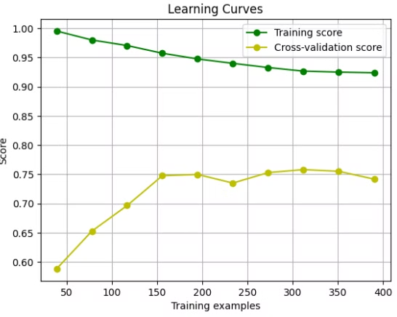
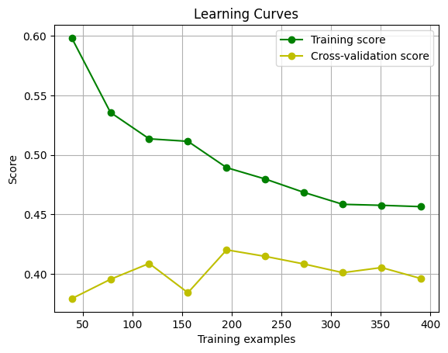


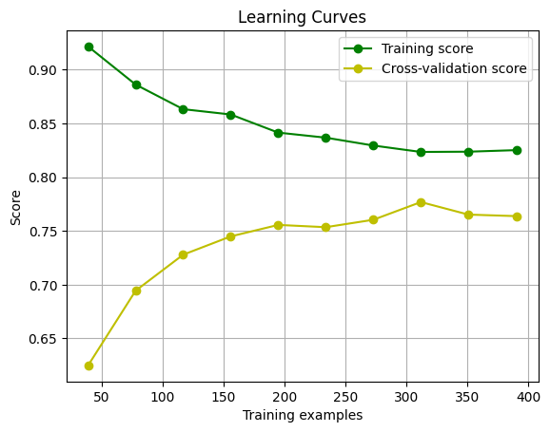
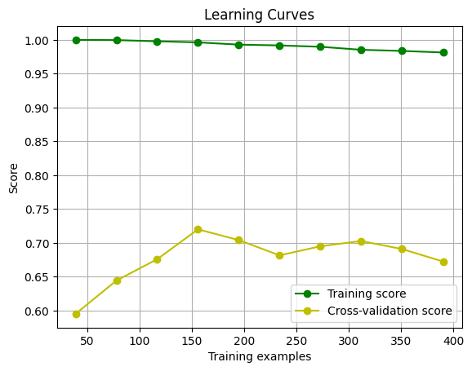


Learning Curves
Learning curves visualize model performance as training set size increases. We examine curves for decision trees with different maximum depths.
Training Score
Measures how well the model fits the training data.
Cross-validation Score
Estimates model performance on unseen data.
Convergence
Ideal curves converge at a high score as training size increases.

Slide 6

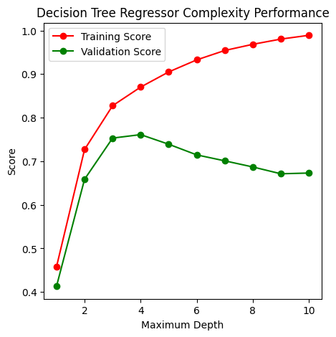

Bias-Variance Tradeoff
We analyze the bias-variance tradeoff using complexity curves. These show model performance as the maximum depth increases.
Low Depth
High Bias
Underfitting
High Depth
High Variance
Overfitting
Optimal Depth
Balance
Best Generalization

Slide 7

Grid Search Optimization
We use grid search to find the optimal maximum depth for our decision tree model. This technique systematically tests various hyperparameter combinations.
Parameter Grid
Define a range of max_depth values from 1 to 10.
Cross-validation
Use ShuffleSplit with 10 splits and 20% test size.
Scoring Function
Use R-squared metric to evaluate model performance.
Best Estimator
Select the model with the highest cross-validation score.

Slide 8



Optimal Model Selection
After grid search, we found the optimal maximum depth for our decision tree model. This balances model complexity and generalization ability.
Optimal Depth
Balanced Model
Generalization
The best max_depth value was determined to be 4.
This depth provides a good tradeoff between bias and variance.
The model should perform well on unseen data.

Slide 9

Making Predictions
We use our optimized model to predict housing prices for three hypothetical clients. Each client's home has different features.
Client
Rooms
Poverty %
Student-Teacher Ratio
Predicted Price
1
5
17%
15-to-1
$403,025
2
4
32%
22-to-1
$237,479
3
8
3%
12-to-1
$931,636

Slide 10

Conclusion and Next Steps
Our model successfully predicts housing prices based on key features. However, there's always room for improvement in machine learning projects.
1
Model Performance
The decision tree model provides reasonable predictions for different housing scenarios.
2
Limitations
The model may not capture all factors influencing housing prices.
3
Future Work
Consider ensemble methods or additional features to enhance prediction accuracy.

Slide 11
Any Questions

Slide 12
Thanks

